Slide 1
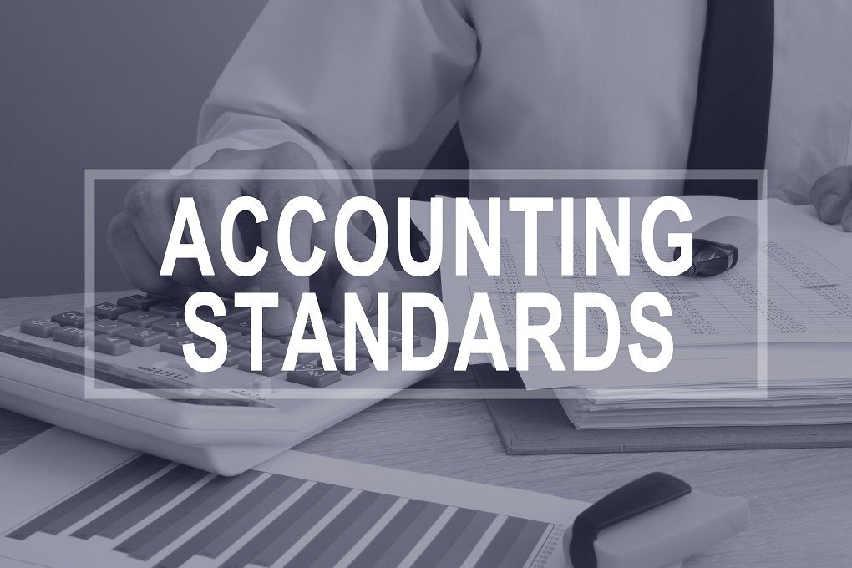
Ind-AS,IFRS, and GAAP

Slide 2

LECTURE OUTCOMES
To Appraise the adoption process of IFRS in India.
To Describe the requirements of IFRS convergence in India.
To Compare the Indian GAAP, IFRS and Ind-AS.

Slide 3

Are Accounting Standards Important?
Notes:
The main objective of Accounting Standards is to standardise the diverse accounting policies and practice

Slide 4

Lets explore what is happening in the Accounting world?
Harmonization of Accounting
Harmonization tends to mean the process of increasing the compatibility of accounting practices by setting bounds to their degree of variation.

Slide 5




The need for harmonization of accounting standards
Each country has its own accounting regulation.
Multinational entities may have to prepare reports on activities on several basis for use in different countries, and this can cause unnecessary financial costs.
Preparation of financial statements based on different principles makes it difficult for investors and analysts to interpret financial information.
Increasing levels of cross border financing transactions, securities trading and direct foreign investment need single set of rules.

Slide 6
Lets understand with an example
Investors would like to direct their capital to the most efficient and productive companies globally provided they are in position to understand their accounting/financial reports.
So, if all countries across globe would have adopted the standard/single accounting standards.
It makes easier to use financial reports for taking prudent investment decisions by investors across their borders.
Hence, it lays down the rationale behind the harmonization of accounting standards across globe.

Slide 7
What are International Financial Reporting Standards (IFRS)?
The IFRS develops high-quality, understandable, enforceable and globally accepted accounting and sustainability disclosure standards.
Developed by
International Accounting Standards Board (IASB)
IFRS Accounting Standards
IFRS Sustainability Disclosure Standards
International Sustainability Standards Board (ISSB)
How a company prepares its financial statements
How a company discloses information about sustainability-related factors
Notes:
The two boards will work closely to ensure their Standards complement each other to provide investors with transparent and reliable information about a company’s financial position and performance, as well as information about sustainability factors that could create or erode its enterprise value in the short, medium and long term.

Slide 8
A) IFRS Foundation
In 1997, restructure IASC into two bodies – the Trustees and the International Accounting Standards Board (IASB).
IFRS Foundation (March 2001)
trustees are responsible for:
appointing the members of the IASB, the International Financial Reporting Interpretations Committee and IFRS Advisory Council;
reviewing annually the strategy of the IASB and its effectiveness;
approving annually the budget and determining the funding of the IASB;
promoting the IASB and its work and the rigorous application of IASs;
establishing and amending operating procedures for the IASB, IFRS Interpretations Committee and IFRS Advisory Council.

Slide 9
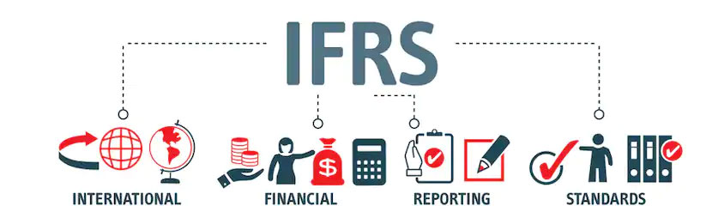
B) International Accounting Standards Board (IASB)
Responsible for developing international accounting standards, now called International Financial Reporting Standards (IFRSs).

Slide 10
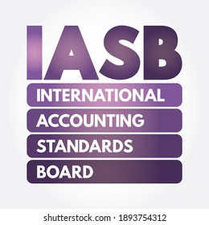
C) IFRS Advisory Council (Objectives)
to give advice to the IASB on agenda decisions and priorities in its work;
to inform the IASB of the views of organizations and individuals on the Council on major standard setting projects;
to give other advice to the Board or to the Trustees.

Slide 11
D) IFRS Interpretations Committee (Responsibilities)
Review, on a timely basis, new financial reporting issues not specifically addressed in IFRSs.
Clarify issues where unsatisfactory or conflicting interpretations have developed, with a view to reaching a consensus on the most appropriate treatment.

Slide 12
Poll 1:
Under the current structure of regulatory bodies, which of the bodies listed below acts as the overall supervisory body in IFRS?
A IFRS Interpretations Committee
B International Accounting Standards Board
C IFRS Advisory Council
D IFRS Foundation
Notes:
D

Slide 13
Poll 2:
Which of the bodies listed below is responsible for reviewing International Accounting Standards and issuing guidance on their application?
A IFRS Interpretations Committee
B International Accounting Standards Board
C IFRS Advisory Council
D IFRS Foundation
Notes:
A

Slide 14
Need of IFRS by Companies
Globalization
To reduce the differences between accounting standards
International Acquisitions
Enhance confidence among the global stakeholders

Slide 15
Mode of IFRS Compliance
IFRS adoption: countries are adopting IFRS as it is.
IFRS convergence: countries are preparing own standards but in line with IFRS.
Two Modes
Convergence
Adoption

Slide 16
Poll 3:
A country’s Central Government is being suggested to follow International Accounting Standards by its Accounting Professional Body to facilitate the investment climate in country. However, Central Government’s representative raised an issue that country’s economic environment is different as compared to economic environment that is being presumed to be in existence by IFRS.
Suggest, the given country should follow IFRS?
Yes
No

Slide 17
If yes, How should that country follow IFRS?
Through convergence
Difference between harmonization and convergence?

Slide 18
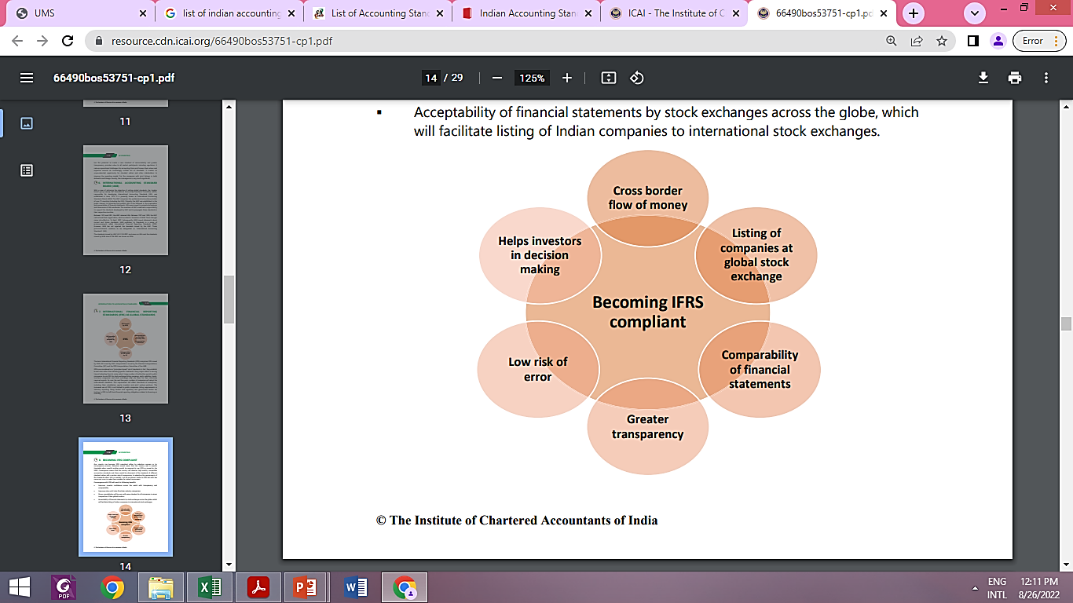


Slide 19
Indian approach to move to IFRS
Made commitment to G20 to follow IFRS from 2011.
IFRS by convergence not by adoption as convergence gives a scope for making country specific changes.
Converged accounting standards with IFRS be named as Indian Accounting Standards (Ind AS).
Implemented Ind AS on voluntary basis for all companies (with comparatives) from April 1, 2015.
However, IFRS was implemented from April 1, 2016 for specified companies on mandatory basis.

Slide 20

GAAP-Introduction
Accounting is the language of business. It communicates the results and state of affairs.
This language follows some accounting principles.

Slide 21
GAAP
Accounting principles
Concepts
Conventions
Accounting principles are accepted worldwide or by different countries, are known as GAAP.

Slide 22
What are Ind-AS?
IND AS stands for Indian Accounting standards notified by the Ministry of Corporate Affairs, Government of India which are converged with IFRS.
These standards are formulated by Accounting Standards Board (ASB) of Institute of Chartered Accountants of India (ICAI).
Accounting standards deal with aspects of accounting events
Recognition of events and transactions
Measurement of transactions and events
Presentation of transactions and events
Disclosure requirements

Slide 23
Current Scenario
Indian Accounting Standards
Existing Accounting Standards under Companies (Accounting Standard) Rules, 2006
IFRS converged Indian Accounting Standards (Ind AS)
Ind AS are named and numbered in the same way as the corresponding IFRS.

Slide 24
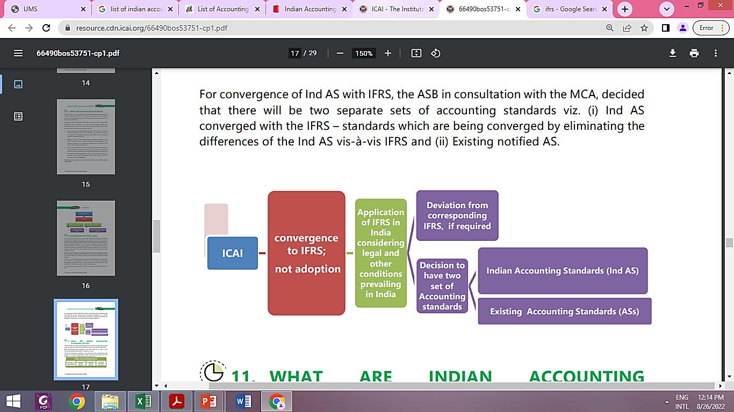

Slide 25
AS
AS 1 Disclosure of Accounting Policies
AS 2 Valuation of Inventories
AS 3 Cash Flow Statements
AS 4 Contingencies and Events Occurring After the Balance Sheet Date
AS 5 Net Profit or Loss for the Period, Prior Period Items and Changes in Accounting Policies
AS 7 Construction Contract
AS 9 Revenue Recognition
AS 10 Property, Plant and Equipment
AS 11 The Effects of Changes in Foreign Exchange Rates
AS 12 Accounting for Government Grants
AS 13 Accounting for Investments
AS 14 Accounting for Amalgamations
AS 15 Employee Benefits
AS 16 Borrowing Costs
AS 17 Segment Reporting

Slide 26
AS 18 Related Party Disclosures
AS 19 Leases
AS 20 Earnings Per Share
AS 21 Consolidated Financial Statements
AS 22 Accounting for Taxes on Income
AS 23 Accounting for Investments in Associates in Consolidated Financial Statements
AS 24 Discontinuing Operations
AS 25 Interim Financial Reporting
AS 26 Intangible Assets
AS 27 Financial Reporting of Interests in Joint Ventures
AS 28 Impairment of Assets
AS 29 Provisions, Contingent Liabilities and Contingent Assets

Slide 27
IND-AS
Ind AS 101 First-time Adoption of Indian Accounting Standards
Ind AS 102 Share based Payment
Ind AS 103 Business Combinations
Ind AS 104 Insurance Contracts
Ind AS 105 Non current Assets Held for Sale and Discontinued Operations
Ind AS 106 Exploration for and Evaluation of Mineral Resources
Ind AS 107 Financial Instruments: Disclosures
Ind AS 108 Operating Segments
Ind AS 1 Presentation of Financial Statements
Ind AS 2 Inventories
Ind AS 7 Statement of Cash Flows
Ind AS 8 Accounting Policies, Changes in Accounting Estimates and Error

Slide 28
IND-AS
Ind AS 10 Events after the Reporting Period
Ind AS 11 Construction Contracts
Ind AS 12 Income Taxes
Ind AS 16 Property, Plant and Equipment
Ind AS 17 Leases
Ind AS 18 Revenue
Ind AS 19 Employee Benefits
Ind AS 20 Accounting for Government Grants and Disclosure of Government Assistance
Ind AS 21 The Effects of Changes in Foreign Exchange Rates
Ind AS 23 Borrowing Costs
Ind AS 24 Related Party Disclosures
Ind AS 27 Consolidated and Separate Financial Statements
Ind AS 28 Investments in Associates

Slide 29
IND-AS
Ind AS 29 Financial Reporting in Hyperinflationary Economies
Ind AS 31 Interests in Joint Ventures
Ind AS 32 Financial Instruments: Presentation
Ind AS 33 Earnings per Share
Ind AS 34 Interim Financial Reporting
Ind AS 36 Impairment of Assets
Ind AS 37 Provisions, Contingent Liabilities and Contingent Assets
Ind AS 38 Intangible Assets
Ind AS 39 Financial Instruments: Recognition and Measurement
Ind AS 40 Investment Property

Slide 30
Phases of Adoption of Ind AS
Phase I
Mandatory applicability of IND AS to all companies from 1st April 2016, provided:
Phase II
Mandatory applicability of IND AS to all companies from 1st April 2017, provided:
It is a listed or unlisted company
Its Net worth is greater than or equal to Rs. 500 crore*
*Net worth shall be checked for the previous three Financial Years (2013-14, 2014-15, and 2015-16).
It is a listed company or is in the process of being listed (as on 31.03.2016)
Its Net worth is greater than or equal to Rs. 250 crore but less than Rs. 500 crore (for any of the below mentioned periods).
Net worth shall be checked for the previous four Financial Years (2014-14, 2014-15, 2015-16, and 2016-17).

Slide 31
Phases of Adoption of Ind As
Phase III
Mandatory applicability of IND AS to all Banks, NBFCs, and Insurance companies from 1st April 2018, whose:
Net Worth shall be checked for the past 3 financial years (2015-16, 2016-17, and 2017-18).
Net worth is more than or equal to INR 500 crore with effect from 1st April 2018.
Phase IV
All NBFCs whose Net worth is more than or equal to INR 250 crore but less than INR 500 crore shall have IND AS mandatorily applicable to them with effect from 1st April 2019.

Slide 32
Poll-4:
As being an active investor of Indian capital markets, if you face some financial reporting issue in the annual reports of certain companies related to certain accounting standard, which body will you refer to raise that issue?
Company Law Board
Institute of Chartered Accountants of India
Income Tax Department
Reserve Bank of India
Notes:
B

Slide 33
Poll 5:
Once a company has started reporting as per the IND AS through Voluntary adoption, Can it further change to reporting its Financial information as per previous law/accounting standards?
Yes
No

Slide 34
B
Companies can voluntarily choose to incorporate IND AS in their reports for accounting periods beginning on or after April 01, 2015.
While reporting, such companies must include a comparative report for the periods ending 31 March 2015 or thereafter, where IND AS have been incorporated to present a comparative view.
However, once a company has started reporting as per the IND AS, it cannot change to reporting as per previous laws.

Slide 35
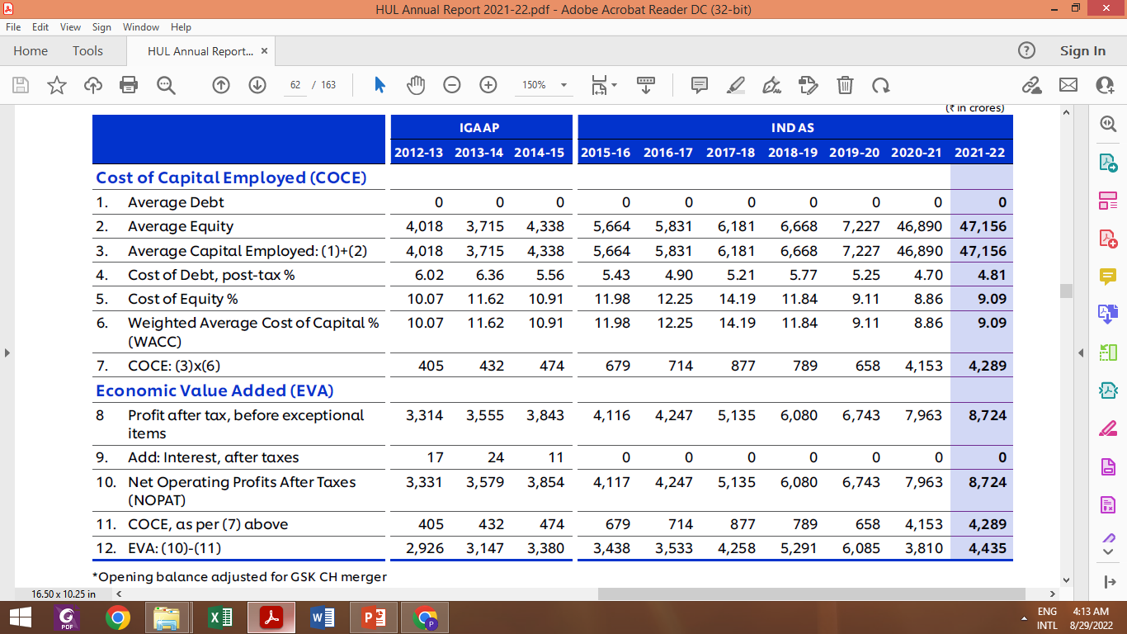
HUL ANNUAL REPORT 2021-2022
Notes:
HUL Annual report

Slide 36
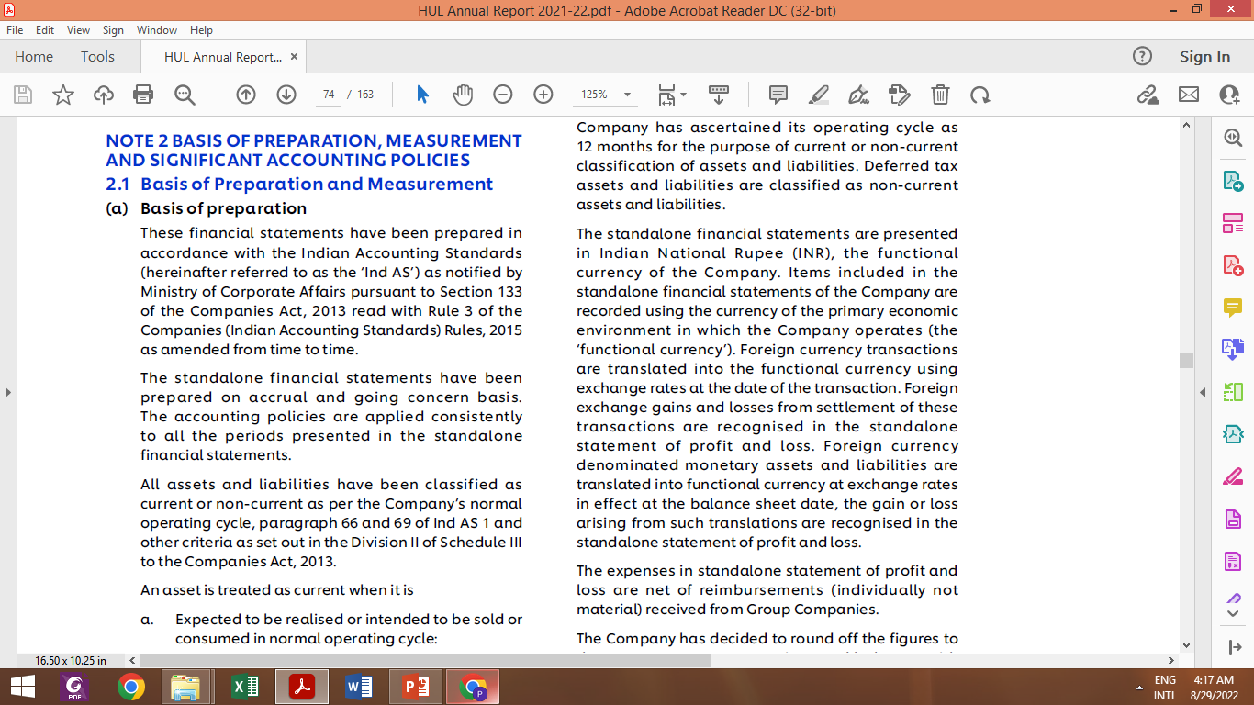

Slide 37
Comparison Between Indian GAAP, IND AS and IFRS
BASIS | INDIAN GAAP | IFRS | IND AS
Components of financial statements | Balance sheet, Statement of Profit & loss Cash flow statement Explanatory notes with significant accounting policies Comparative figures for one year are also to be presented | Statement of financial position Statement of income with profit / loss Statement of cash flows Statement of changes in equity Notes with summary of significant accounting policies Comparative figures for one year are also to be presented | balance sheet at the end of the period including changes in equity Statement of profit / loss Cash flow statement Explanatory notes with significant accounting policies Comparative figures for one year are also to be presented
Formats of financial statements | Under Schedule VI of companies Act 1956 have provided earlier. Now, Under Schedule III of Companies Act, 2013 | Only illustrative formats have been given | No format prescribed

Slide 38
Comparison Between Indian GAAP, IND AS and IFRS
BASIS | INDIAN GAAP | IFRS | IND AS
Bank overdraft | Financing activities | Cash &cash equivalents | Same as IFRS
Cash flows from extra ordinary items | To be classified as operating, financing and investing activities. | Cash flow statements do not reflect any items as extraordinary | Same as IFRS
Interest and dividend | For financial entities: Interests paid/received or Dividend received are to be received as operating activities. Dividend paid to be classified as financing activities | May be classified as operating/investing/financing activities in a manner consistent from time to time | Same as Indian GAAP
Dividends | Dividends declared or proposed after balance sheet date but before approval of financial statements will have to be recorded as a Current liability. | Declared dividend to be recognized in the period when it is declared. | Same as IFRS

Slide 39
Comparison Between Indian GAAP, IND AS and IFRS
BASIS | INDIAN GAAP | IFRS | IND AS
Convertible Debt | The entire instrument is treated as Debt based on its legal form | Shareholders’ Fund | Same as IFRS
PARENT COMPANY | Any company holding 51% or more share of subsidiary | Any company having control on decision making or control on the ownership of other company | Same as IFRS
Cash Flow Statement | Exempted if SMEs | No such exemption | Same as IFRS
Property , plant and equipment | AS 6- DEPRICIATION ACCOUNTING AS 10 - ACCOUNTING FOR FIXED ASSETS | IAS 16- Property, plant and equipment | IND AS 16- Property, plant and equipment

Slide 40
Poll 6:
One Indian MNC which has 7 subsidiaries and 3 associates operating in India is required to follow Ind AS for preparing its financial statements as per the guidelines of MCA. The given MNC will be required to prepare which financial statements as per Ind AS?
a) both consolidated as well as standalone financials of the company
b) Only consolidated financials
c) Only standalone financials
d) Optional
Notes:
A

Slide 41


